Slide 1

ESP’s Core
Management System
An overview of ESP’s cloud-based business management Software Platform

Slide 2
Increase Productivity
ESP’s CORE software system saves your business time (and therefore money).
It’s user friendly nature means that training is a breeze, so lots of time is saved.
Staff are notified when something needs to happen, not when they stumble across some data.
Processes are consistent, meaning that time is saved in all areas of your business

Slide 3

Eliminate
Data Issues
No more ‘spreadsheet sprawl’ with Excel documents spread all over your systems, they’ll all be stored in one simple to access location.
Get rid of those pesky Access Databases
Your data works for you with ESP Core, sending convenient notifications when the data meets the criteria that you set.
Cloud based. No need to worry about data access from home, ESP Core is fully web browser based.
Centralised data. ESP Core can pull data from lots of other different systems, surfacing it all in one convenient location.
Scalable. ESP Core has the capability to store many thousands or even millions of records.
Controlled implementation. ESP Core allows you to solve each business problem one-at-a-time.

Slide 4

Easy Notifications
Hands you the ability to schedule when you want to receive updates about your data.
Provides you with the ability to notify different departments on different schedules as their data needs attention.
Monitor your progress, with easy to use filtering tools throughout the system.

Slide 5

Designed for ease of use
Accessible by registered users via a web browser. Can also be accessed on mobile devices.
Save time on the usual paper-based or excel admin tasks.
Upgradeable with the ability to implement lots of add-on systems as well as downloading content types from other sources.
Export data to other systems in CSV, Excel or PDF Formats
Cloud based so no resource required. All hosted and fully supported by ESP Projects.
Brand the system to match your corporate colours and include your logo
Easy comments system so that your staff can discuss the data on the same screen and tag staff into a conversation to bring their attention to it
Active Directory integrated, so your users don’t have to remember a separate username and password.

Slide 6



Key Aspects
Simple Navigation
User friendly navigation providing at-a-glance info. Get headline stats for your data and export it to Excel for further interrogation.
Complete Control
Track and export key information to and from other systems in a range of formats.
Cloud Based
Securely hosted and backed-up in the cloud to provide the flexibility to access the application from any device.

Slide 7
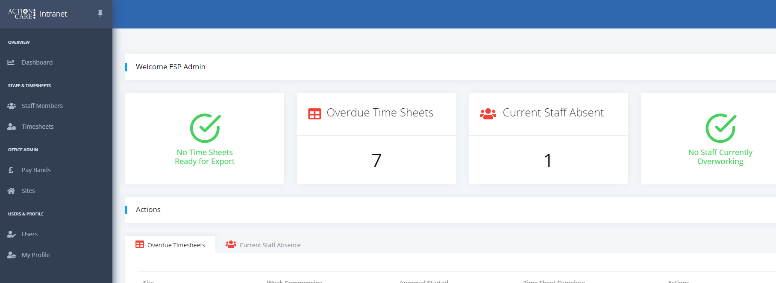
Dashboards Views
Provide a workflow to allow you to keep on top of your payroll requirements.
Track timesheet submissions and follow-up on missing information from multiple sites.
Easily monitor team member attendance profiles.

Slide 8
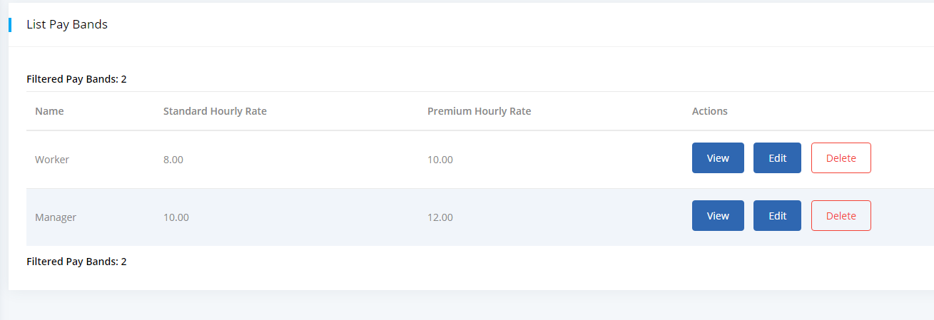
Pay Bands
Apply multiple pay bands with their own rates and allocate to staff. Specify overtime criteria.

Slide 9
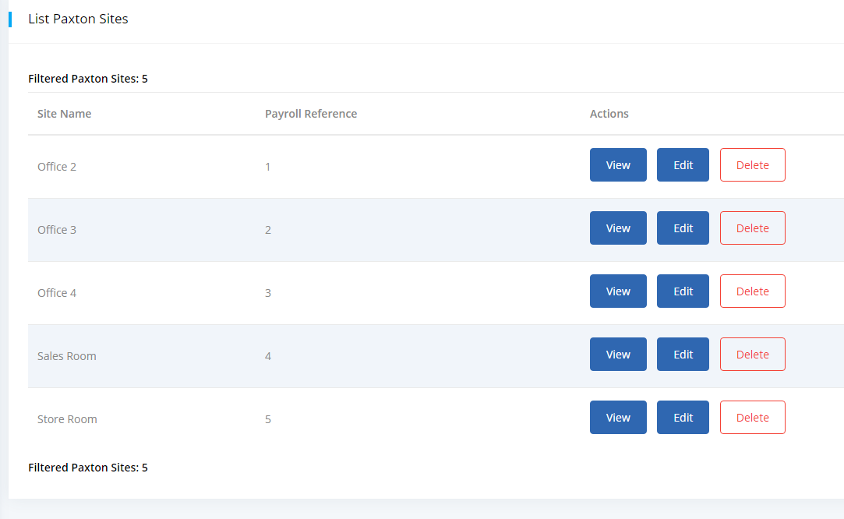

Content Type Management
Add as many items as you want
Display the items in a list (you choose the headings)
Give permission to users to view/edit/delete items independently

Slide 10
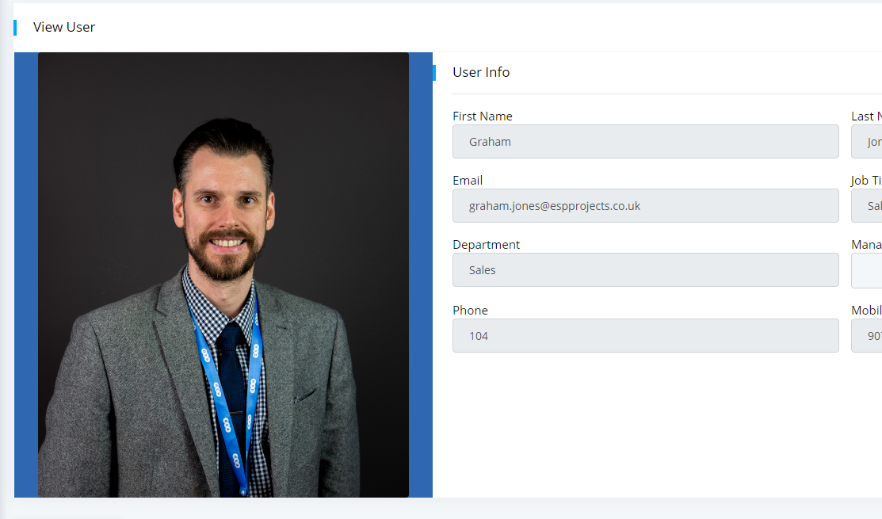
User Management
Manage user profiles easily
View and change permission levels
Show pictures of staff

Slide 11
Integrate and Expand
Integrate
Integrate with other systems such as Sales or finance software – Dynamics or Sage (others are available).
Save Time
Save on admin time with consistent views and uniform screens.
Grow
Grow the system with other timesaving tools using ESP’s EIS Intranet system including HR, Time and Attendance Management & more.

Slide 12
Summary
ESP Core offers simple effective solutions to better capture data within your organisation.
ESP Core allows you to choose which data to capture for your business.
ESP Core allows you to build your own screens, with your own field selections.
One platform that provides secure access to all your information ready to export to other systems where necessary.

