Slide 1


Slide 2
Summary
Advanced Manufacturing Execution System (MES)
Core features are Manual Operations & ATE*, Process Control and Reporting Tools
100% traceability of item, time, event, location and person
Promotes effective enterprise-wide collaboration & decision making
Easy to deploy, learn, maintain and scale
Supports internal and supplier continuous improvement methodology
Minimal CAPEX, SaaS model, typical payback in 12mo
Immediate deployment with all core features available from day one, even in multi-site deployments
*ATE = Automatic Test Environment

Slide 3
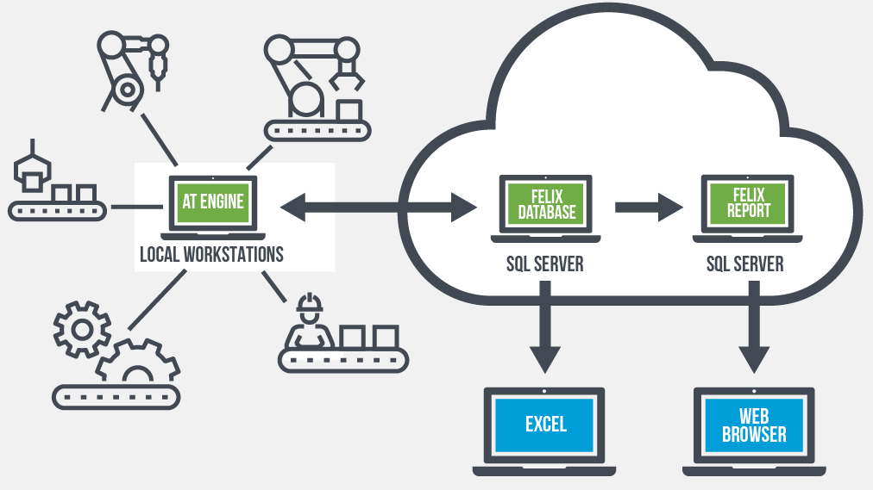
MRP/ERP/CRM
PLM
QMS
Product Design Suite
Manufacturing Operations Software Suite
Cloud based solution with PCs used for data collection and analysis
Information can be accessed securely via any browser
Mixed mode environments with manual and automated operations
Hyper focus on manufacturing process
process control
dashboards & reporting tools
ATE
control

Slide 4
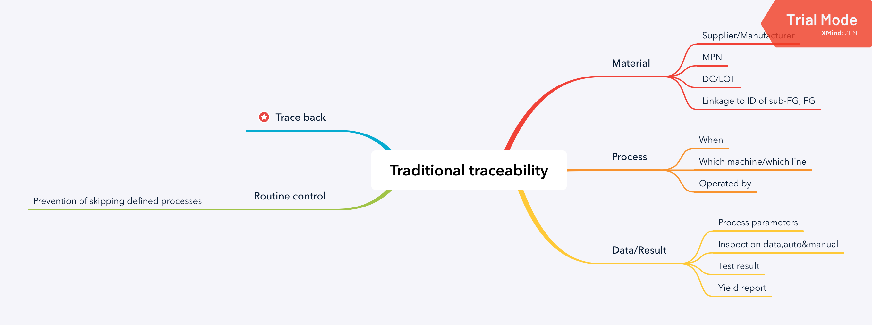

100% control & traceability

Slide 5




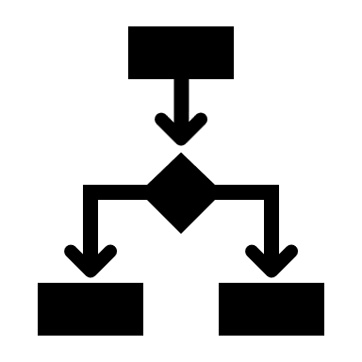
MES is NOT MRP/ERP
Machines & Sensors
All tools and equipment tracked by serial number and calibration status.
Validate runs.
Record Energy use & utilization.
Operators
Record and validate all operator interactions with process via unique operator ID.
Jigs & Fixtures
Tracked by serial number and calibration status.
Record and validate usage.
Material
Tracked by serial or batch number
Record and validate usage.
Confirm & manage product configuration.
Visibility of in-house and supplier raw, WIP & FG.
Process
Enforced routing using serial number
Discrete records for each run including initial, repeats, incomplete & rework.
Record start, pass, fail, complete & cycle time.
Notes:
Real-Time Production Data: Continuous updates on production status, machine performance, and operator activity, enabling immediate adjustments.
Detailed Shop Floor Visibility: Granular tracking of each machine, operator, and work center with data points like speed, downtime, and cycle times.
Context-Rich Data Collection: Collection of specific process conditions (e.g., temperature, humidity, pressure) to add valuable context for each production event.
Digital Twin Modeling: Ability to simulate operations and test scenarios using real-time data, supporting optimization and predictive insights.
Instant Error Detection: Immediate feedback if operational data deviates from expected parameters, similar to a “check engine” alert for production processes.
Closed-Loop Control: Ability to adjust parameters in real time based on live feedback, enabling on-the-fly optimization of processes.
Traceability: End-to-end tracking of materials, products, and components through every step of production for quality control and compliance.
Predictive Maintenance: Analysis of real-time machine data to predict maintenance needs, reducing unexpected downtimes and maintenance costs.
Operator and Process Validation: Verification of operator activities and adherence to process standards, ensuring quality and compliance.
Comprehensive Reporting and Analytics: Detailed reports on production metrics (e.g., OEE, yield, scrap rates) tailored to shop floor needs, beyond the financial data focus of ERP/MRP.

Slide 6
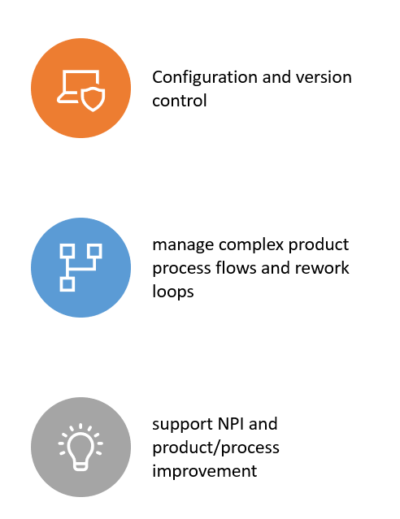
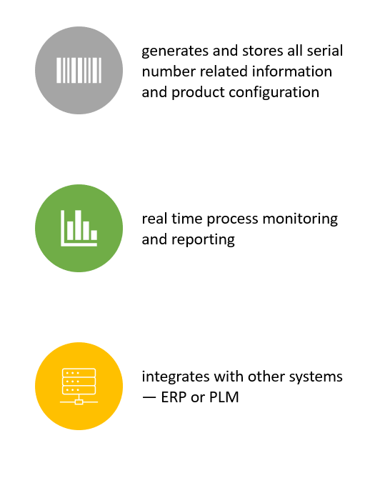
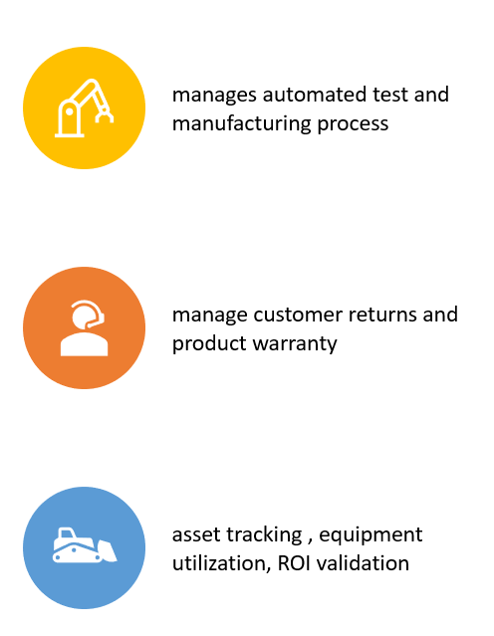
Key Features & Benefits

Slide 7
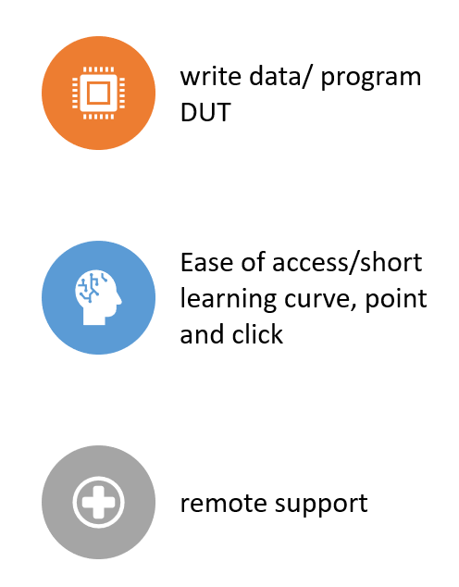
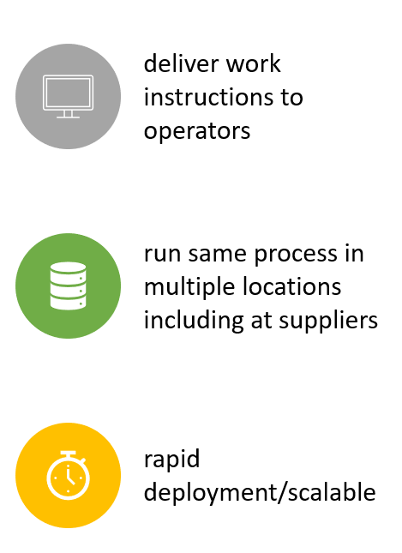
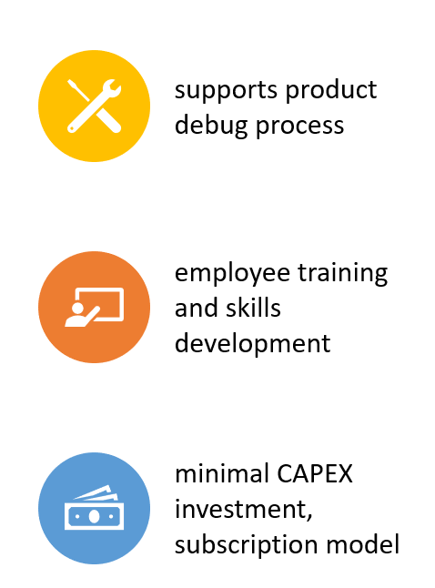
Key Features & Benefits

Slide 8
Curated, Context-Rich Data Collection
Large Data Set for Performance Mapping: Curated, sensor data used to select the ideal performance map
Real-Time Data: Continuous data flow from sensors supports instant adjustments to maintain efficiency.
Single Source of Truth: “check engine” light if discrepancy occurs, reason code generated
Predictive Modeling: The closed-loop nature of data collection supports predictive insights; System learns and improves over time.
Notes:
Large Data Set for Performance Mapping: Car engine’s sensor data used to select the ideal performance map, a curated data set enables precise, optimal decision-making.
Real-Time Data for Immediate Adjustments: Continuous data flow from sensors allows for instant, real-time adjustments to maintain efficiency.
Single Source of Truth: Similar to how an engine generates a “check engine” light if data conflicts arise, a unified data source highlights discrepancies, ensuring reliability.
Predictive Modeling: The closed-loop nature of data collection supports predictive insights, allowing the system to learn and improve over time.

Slide 9
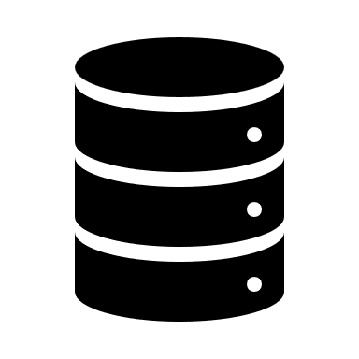


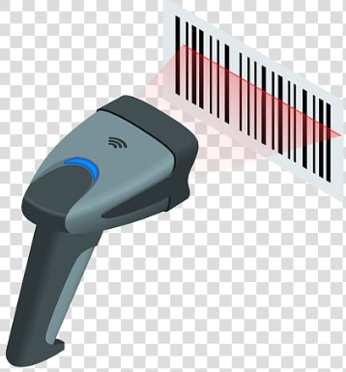




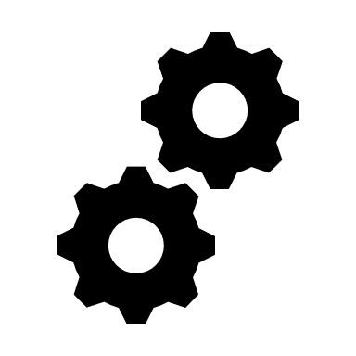



End to end manufacturing process control capability
Suppliers & Partners
Manufacturing Company
Customers
Use of Data
critical
parameters
process
yields
skill development
continuous improvement
real-time data analytics
TRACE FORWARD
resource planning
preventative maintenance
process control
MTBF & PPM data
rejects
FMEA & Root Cause Analysis
product recall management
TRACE BACKWARD
Data Management
Lifecycle Process Control and Reporting Platform
supplier production records
operators
batch no
process
map
process results
work
instructions
MRP/ERP
QA Software
CPK data
machine utilization
process yields
Field performance data
Maintenance records
RMA request
machines
serial no
sensors
event duration
tools &
fixtures
PLM/PDM
Dashboards
WIP
custom reports
process throughput
Data Collection
AT State
AT Operator
AT Instrument
AT Dispatch
AT Config
AT Allocate
AT DevChar
AT Engine e
AT Returns
Reporting
sample qty builds
qualification testing
process development
PPAP process
certification
volume ramp
test data & process status
process control and machine calibration & control
operator training
inspection results, continuous improvement & product sampling
rework and material recovery process
preventative maintenance
process metrics , CPK & KPIs
space model
proto builds
initial data
debug
root cause analysis
repair process
material recovery
disposal process
re-use
traceability of raw material &
components
R&D
NPI
Volume Production
RMA
Disposal
traceability of material and process history of fielded population
traceability of material, items & sub-items, process events, operators, environment, machines, tools, fixtures
100% product lifecycle traceability

Slide 10
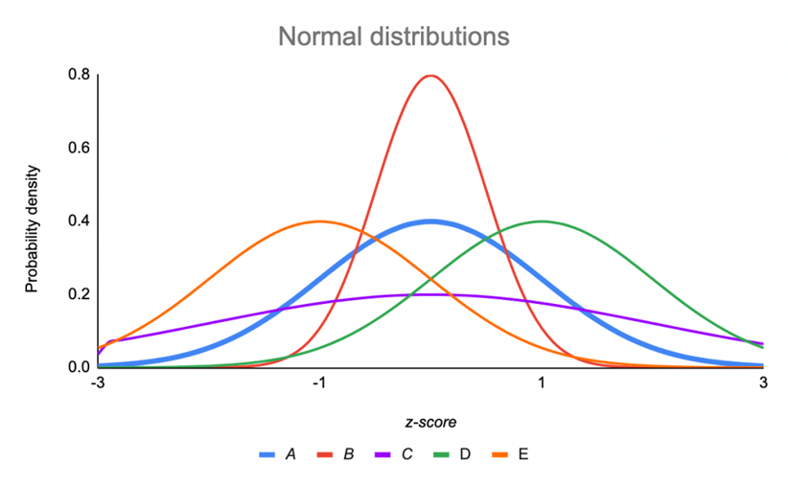
Manufacturing Process Optimization
dynamic data analysis problem
complex, multi-dimensional, with large variable set
requires responsive feedback loop to deliver optimized outcomes
can be modeled to create a digital twin
Model can evolve/learn over time, based on inputs and experience
Data Analysis, AI queries and results are personalized to your business
bottlenecks, yield, throughput, productivity, MU change based on product mix & volume

Slide 11
Transformation through your data
Performance Metrics
real-time job status
actual vs plan
capture entire data set for process
process yields , CPK, FMEA, continuous improvement
machine utilization
energy use
compare runs
real-time decision making
Data driven decision making
optimize process though continuous improvement
develop digital twin
Process optimization using dynamic modelling , historical & real-time data sets
‘Talk’ to your data
data modelling tools
expose your data to AI Tools
run ‘what if’ process and use AI Tools to optimize model , planning & pricing
on-board reporting
data analysis tools
use collected data to model process
baseline & set objectives

Slide 12





www.felixcloudsolutions.com
sales@felixcloudsolutions.com
helpdesk@felixcloudsolutions.com
felixcloudsolutions

