Slide 1
AutoNDE
Explainable AI for DAMAGE characterisation
ound
Mathematics Ltd.

Slide 2
Problem
NDT (Non-Destructive Testing) is a technique used by many industries to evaluate components and structure without causing any damage. Data collection is being automated at a large pace, while automation of data interpretation is lagging behind. To give just one example, three out of France's 56 nuclear reactors have been shut in January because of the cracks found near welds on their safety cooling systems. This accounts for a prolonged loss of over 6% of the France's nuclear capacity. Regular NDT inspections significantly reduce the likelihood of major accidents. However, the industry faces shortage of suitably qualified personnel, and conclusions made by NDT inspectors are not 100% reliable.

Slide 3
Solution
For several years now SML (Sound Mathematics Ltd.) has been developing AutoNDE, a unique explainable AI for interpreting data collected with a linear PAUT (Phased Array of Ultrasonic Transducers). AutoNDE has been designed to characterise cracks and extent of corrosion, relying on a modification of a widely used signal processing algorithm TFM (Total Focusing Method) and innovative approach to taking into account surface undulations - the main source of error. The AI module of AutoNDE is a Decision Tree, which utilises OpenCV image processing algorithms and mimics thought processes of human inspectors. As all decision trees it relies on "if ... then" rules and therefore, produces explainable results.

Slide 4

DPS Experiment
transducer array
0
-10
-40
notched side
water
DPS experiment with notches similar to planar fatigue cracks
notch
notches
steel block
0 50 100 150 200 x, mm
flat side
Notes:
Two standards of assessment used
ASME API-579 Fitness for service Part 5
BS EN 7910 Part G
These standards consist of many different parts covering different potential issues a pressure vessel/structure could suffer from.
Metal loss
Pitting
Brittle fracture
Hydrogen Blisters
Shell distortions and weld misalignments
Etc
The current version of FFS_ASSEES focuses on Localised Metal Loss, as this is a common inspection type and fits with the scope of the chimera project. Pitting is also of interest but presents slightly different challenges for detection and assessment.

Slide 5

DPS DATA:
POSSIBLE INSPECTION REPORT:
FSBuried24mm
******************************************************************************
TFM image
A possible defect is detected.
Defect depth = 8 mm
Defect extent = 9 mm
Defect orientation = 105 deg
Report Quality = 60%
Notes:
The software is capable of stitching together individual strip scans into one large corrosion map covering an entire section of the vessel, for instance the head of the vessel, this is useful as the calculations for the stresses around metal loss depend on the surface geometry and areas of corrosion can often overlap individual strip scans of the section.
We have used OpenCV as our vision API and written a function to mimic the decision making process of the engineer and the requirements of the standards to identify potential areas of metal loss for inspection.
Suspect data is also highlighted and not processed. Areas of corrupted/missing data which are small enough can have values interpolated from neighbouring values but larger areas are flagged for the engineer to re-scan.
These individual areas of metal loss are then profiled and assessed as per the fitness for service assessment. First for a level 1 assessment is performed and if the criteria are not met a further more detailed level 2 assessment is then performed taking into account the proximity to vessel features such as weld lines and support structures.

Slide 6

Westinghouse DATA:
POSSIBLE INSPECTION REPORT:
Westinghouse_across_opposite
************************************************************************
TFM image
A possible planar defect is detected.
Defect depth = 9 mm
Defect extent = 7 mm
Defect orientation = 0 deg
Notes:
The software is capable of stitching together individual strip scans into one large corrosion map covering an entire section of the vessel, for instance the head of the vessel, this is useful as the calculations for the stresses around metal loss depend on the surface geometry and areas of corrosion can often overlap individual strip scans of the section.
We have used OpenCV as our vision API and written a function to mimic the decision making process of the engineer and the requirements of the standards to identify potential areas of metal loss for inspection.
Suspect data is also highlighted and not processed. Areas of corrupted/missing data which are small enough can have values interpolated from neighbouring values but larger areas are flagged for the engineer to re-scan.
These individual areas of metal loss are then profiled and assessed as per the fitness for service assessment. First for a level 1 assessment is performed and if the criteria are not met a further more detailed level 2 assessment is then performed taking into account the proximity to vessel features such as weld lines and support structures.

Slide 7
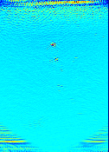
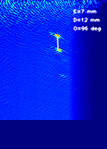
AMEC DATA:
POSSIBLE INSPECTION REPORT:
AMEC data
************************************************************************
TFM image (uncropped) TFM image (cropped)
A possible defect is detected.
Defect depth = 15 mm
Defect extent = 6 mm
Defect orientation = 95 deg
Report Quality = 50%
Notes:
The software is capable of stitching together individual strip scans into one large corrosion map covering an entire section of the vessel, for instance the head of the vessel, this is useful as the calculations for the stresses around metal loss depend on the surface geometry and areas of corrosion can often overlap individual strip scans of the section.
We have used OpenCV as our vision API and written a function to mimic the decision making process of the engineer and the requirements of the standards to identify potential areas of metal loss for inspection.
Suspect data is also highlighted and not processed. Areas of corrupted/missing data which are small enough can have values interpolated from neighbouring values but larger areas are flagged for the engineer to re-scan.
These individual areas of metal loss are then profiled and assessed as per the fitness for service assessment. First for a level 1 assessment is performed and if the criteria are not met a further more detailed level 2 assessment is then performed taking into account the proximity to vessel features such as weld lines and support structures.

Slide 8
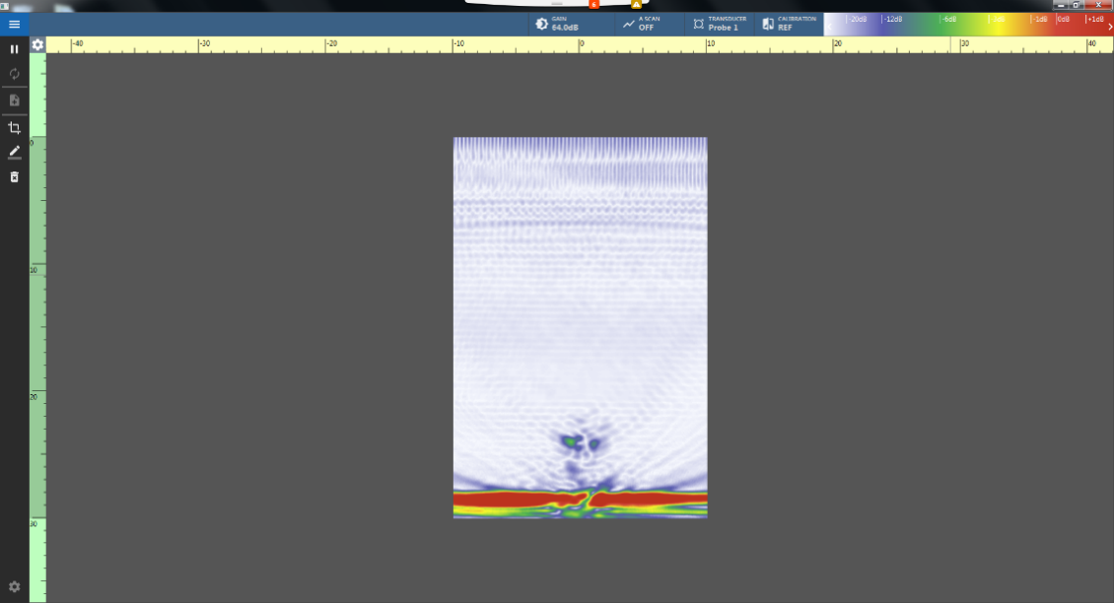
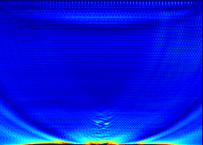
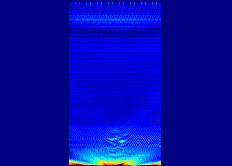
TWI DATA:
POSSIBLE INSPECTION REPORT:
Saturated – Large SCC sample - short length - 5MHz - Indication B2
************************************************************************************
TWI TFM SML TFM SML TFM (cropped)
A possible defect is detected.
Defect depth = 1 mm
Defect extent = 6 mm
Defect orientation = 90 deg
Report Quality = 30%
Notes:
The software is capable of stitching together individual strip scans into one large corrosion map covering an entire section of the vessel, for instance the head of the vessel, this is useful as the calculations for the stresses around metal loss depend on the surface geometry and areas of corrosion can often overlap individual strip scans of the section.
We have used OpenCV as our vision API and written a function to mimic the decision making process of the engineer and the requirements of the standards to identify potential areas of metal loss for inspection.
Suspect data is also highlighted and not processed. Areas of corrupted/missing data which are small enough can have values interpolated from neighbouring values but larger areas are flagged for the engineer to re-scan.
These individual areas of metal loss are then profiled and assessed as per the fitness for service assessment. First for a level 1 assessment is performed and if the criteria are not met a further more detailed level 2 assessment is then performed taking into account the proximity to vessel features such as weld lines and support structures.

Slide 9
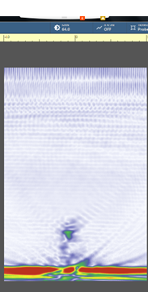


TWI DATA:
POSSIBLE INSPECTION REPORT:
Saturated – Large SCC sample - large length - 5MHz - Indication B1
************************************************************************
TWI TFM SML TFM SML TFM (cropped)
A possible defect is detected.
Defect depth = 1 mm
Defect extent = 5 mm
Defect orientation = 90 deg
Report Quality = 70%
Notes:
The software is capable of stitching together individual strip scans into one large corrosion map covering an entire section of the vessel, for instance the head of the vessel, this is useful as the calculations for the stresses around metal loss depend on the surface geometry and areas of corrosion can often overlap individual strip scans of the section.
We have used OpenCV as our vision API and written a function to mimic the decision making process of the engineer and the requirements of the standards to identify potential areas of metal loss for inspection.
Suspect data is also highlighted and not processed. Areas of corrupted/missing data which are small enough can have values interpolated from neighbouring values but larger areas are flagged for the engineer to re-scan.
These individual areas of metal loss are then profiled and assessed as per the fitness for service assessment. First for a level 1 assessment is performed and if the criteria are not met a further more detailed level 2 assessment is then performed taking into account the proximity to vessel features such as weld lines and support structures.

Slide 10

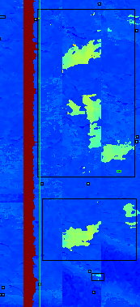

FFS_ASSESS
AutoNDE's functions, which exploit the OpenCV
algorithms, have been also used to develop
FFS_ASSESS software capable of utilising PAUT
data to create corrosion maps and assess pressure vessels' fitness for service. It is intended to merge the two codes
into one.

Slide 11
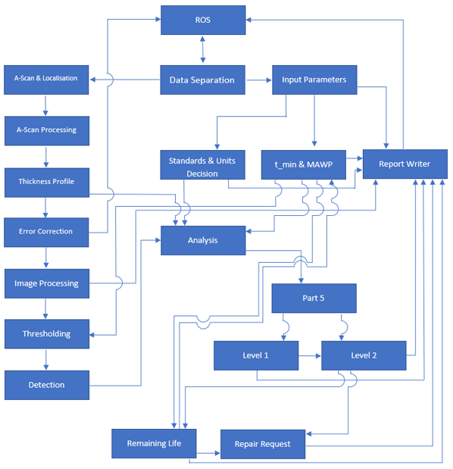
Methods
In order to design the software we converted the assessment process described in the assessment standards into a flow chart.
The software can be tailored to process data from any suitable scanning equipment as soon as these data have been exported in text format.
The only other input expected by FFS_Assess are the pressure vessel design details, such as its geometry, design specifications and working pressure. This input should be provided by a human inspector via a text file.
Notes:
The assessment process is written for an engineer to follow. These steps and calculations were converted into a flow chart to aid in the structuring of the software.
The process sticks as close as possible to the method in the standard to make it as easy as possible to verify that the calculations and values being used are true to the requirements.
With the wealth of different scanning equipment and methods the software can easily be tailored to work with any C-scan data.
The only requirement is that the data are saved in a text format, formatted as .txt or .csv rather than the proprietary formats which many scanning equipment manufacturers use by default.
The only other information the system needs are some details from the vessel plans, such as the geometry, design specifications, working pressure and temperature.
These details are read in via a text file which the user must fill in from the design specification.

Slide 12
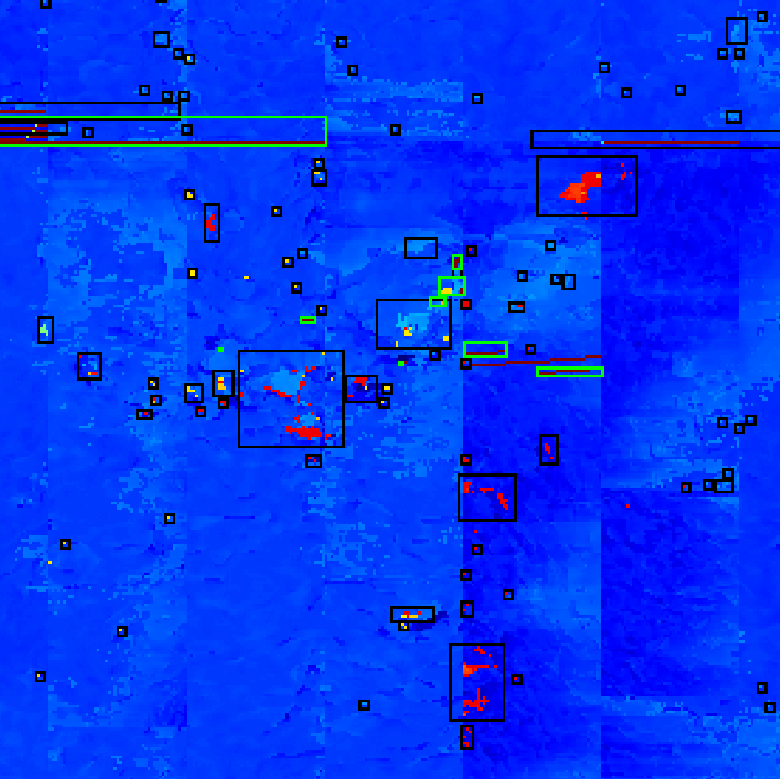
Methods (ctd.)
The software is capable of stitching individual scans into a large scale image of the vessel wall and then decide which areas require assessment based on a minimum allowable thickness process.
Any area identified as needing assessment and containing no missing data or data from failed scans are assessed individually as per the standards.
Notes:
The software is capable of stitching together individual strip scans into one large corrosion map covering an entire section of the vessel, for instance the head of the vessel, this is useful as the calculations for the stresses around metal loss depend on the surface geometry and areas of corrosion can often overlap individual strip scans of the section.
We have used OpenCV as our vision API and written a function to mimic the decision making process of the engineer and the requirements of the standards to identify potential areas of metal loss for inspection.
Suspect data is also highlighted and not processed. Areas of corrupted/missing data which are small enough can have values interpolated from neighbouring values but larger areas are flagged for the engineer to re-scan.
These individual areas of metal loss are then profiled and assessed as per the fitness for service assessment. First for a level 1 assessment is performed and if the criteria are not met a further more detailed level 2 assessment is then performed taking into account the proximity to vessel features such as weld lines and support structures.

Slide 13
Report Production
Inspection reports are produced as HTML for easy web viewing and saving/printing.
If there is an LTA which has failed, then the point of failure from the API-579 standard is quoted, advice regarding rerating the vessel and an estimate for the repair dimensions are given.
If historical figures are available, then an estimated lifespan for the vessel is calculated and a recommended reinspection date is given.
Notes:
Reports are output in HTML for easy viewing on the web, from there they can be easily formatted as desired.
The area of metal loss is presented along with any details of the assessment, if it has failed the standards are quoted so a reviewing engineer can immediately see the issue, recommendations are given regarding rerating the operating pressure of the vessel if that is an option and then giving the dimensions of any repairs that need to take place to bring it back up to specification.
If the user has provided any historical data a corrosion rate can be estimated and a suggested date for the next inspection can be provided to the end user.

Slide 14
Road Map
So far we had about £1 M funding from Innovate UK to develop our unique product. Most developers considering automating NDT data processing are exploring ways of employing standard AI products. However such products require large data and at present no such data is openly available, partly because of its proprietary nature. Also most current AI products produce results that are not explainable and are unlikely to be approved by regulatory bodies.
Developing Decision Trees like ours is known to be an arduous task and most companies and even academic groups do not have the resources to afford such development. However, once developed Decision Trees offer explainable results.
At present we are funded by the Innovate UK a Smart Grant extending AutoNDE capabilities and developing a GUI as recommended by our industrial informants.

Slide 15
Road Map
We wish to start engaging various NDT users and providers. We propose to let them use our software for a very small licence fee on the basis that beta-test it and provide us with their data to keep training our codes and improving its performance. Meanwhile if they find our automatically generated inspection reports acceptable they can start signing them off under their own certification.
We envisage that this strategy will allow us to have about 100 user cases, which can be used for approval by a Regulator.

