Slide 1
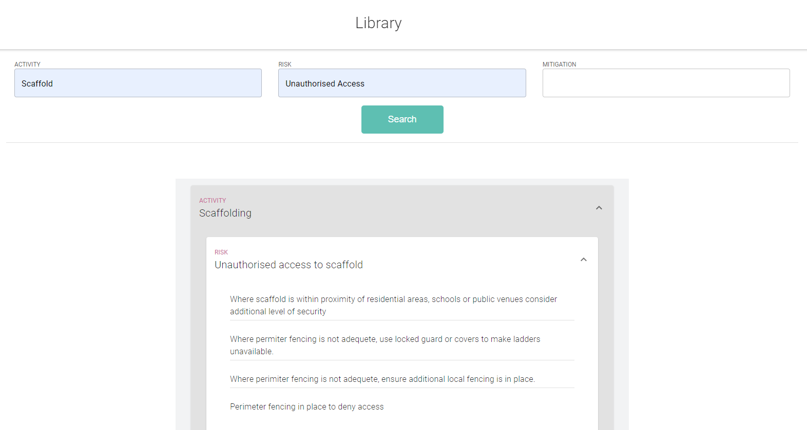
Intuety Bringing AI Into the Workplace
Our freely searchable library utilises symantic search and Natural Language Understanding to provide you with relevant Hazards, Risks and Mitigations based on what you search, instantly.

Slide 2
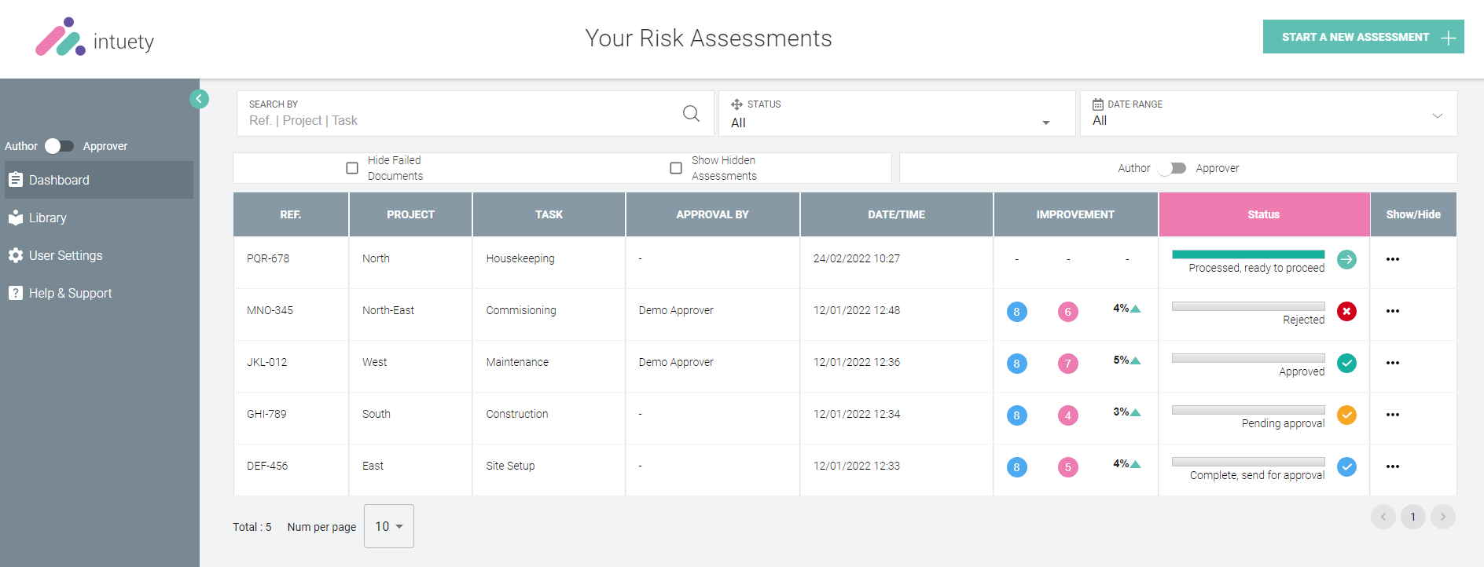
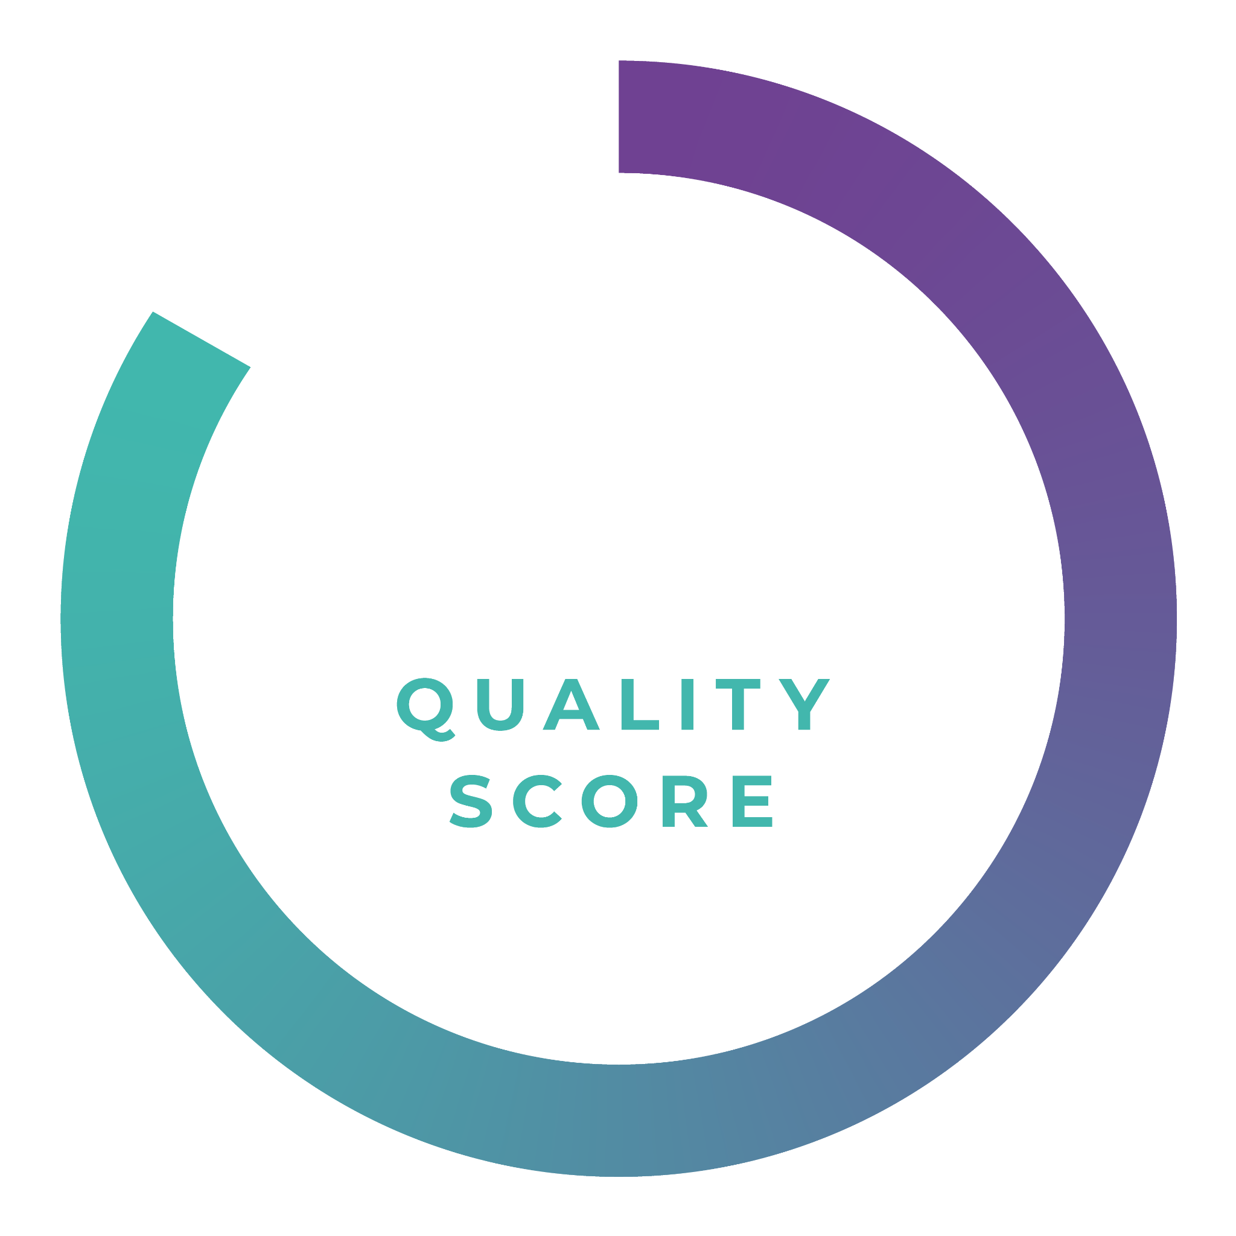
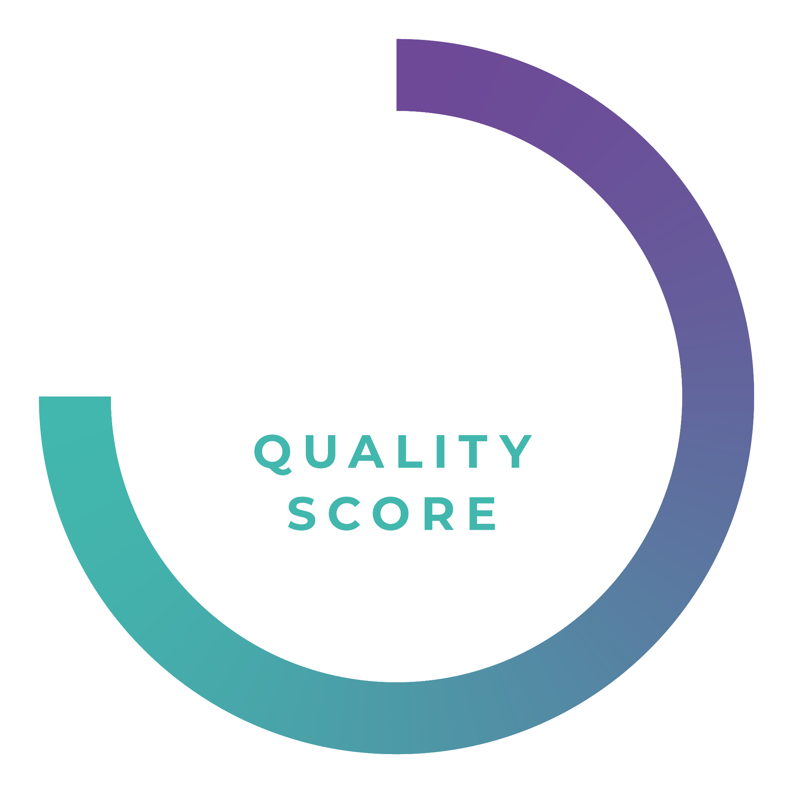
Intuety Bringing AI In To The Workplace
Easy to use platform with simple dashboards
Uniquely providing each upload with a completely objective quality score out of 100% that improves throughout the process. Thus providing an element of gamification that motivates improvements

Slide 3
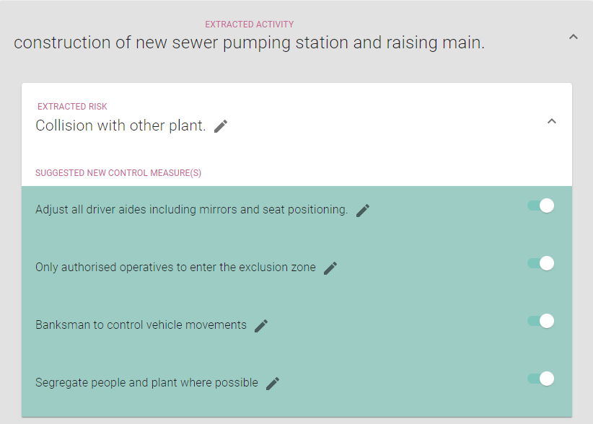
Intuety Bringing AI Into the Workplace
Providing Intelligent suggestions on each RAMs for risks and controls that may not have been considered or otherwise missed therefore improving the quality of the document and lowering the likelihood and severity of presented hazards.
Analysis of the RA and MS, uncovering key improvements and insights, ensuring consistent documentation.

Slide 4
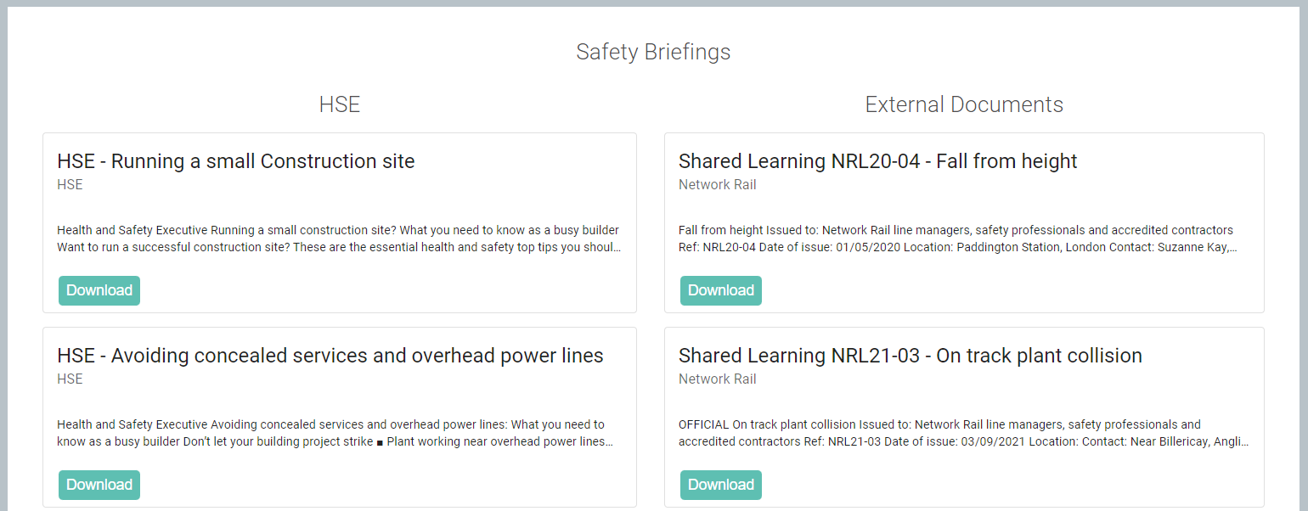
Intuety Bringing AI Into The Work Place
Our corporate memory narrows down thousands of internal and public lessons learned and incident documentation, to a short number of absolutely relevant documents every time.
Automatically identifying your own prohibited plant and equipment.

